Slide 1
City of Shorewood Spring & Summer 2022
Photo Contest Winners

Slide 2
Winners in Each of Four Categories
Spring Wonder
Summer Delights
People and Pets
Wildlife

Slide 3
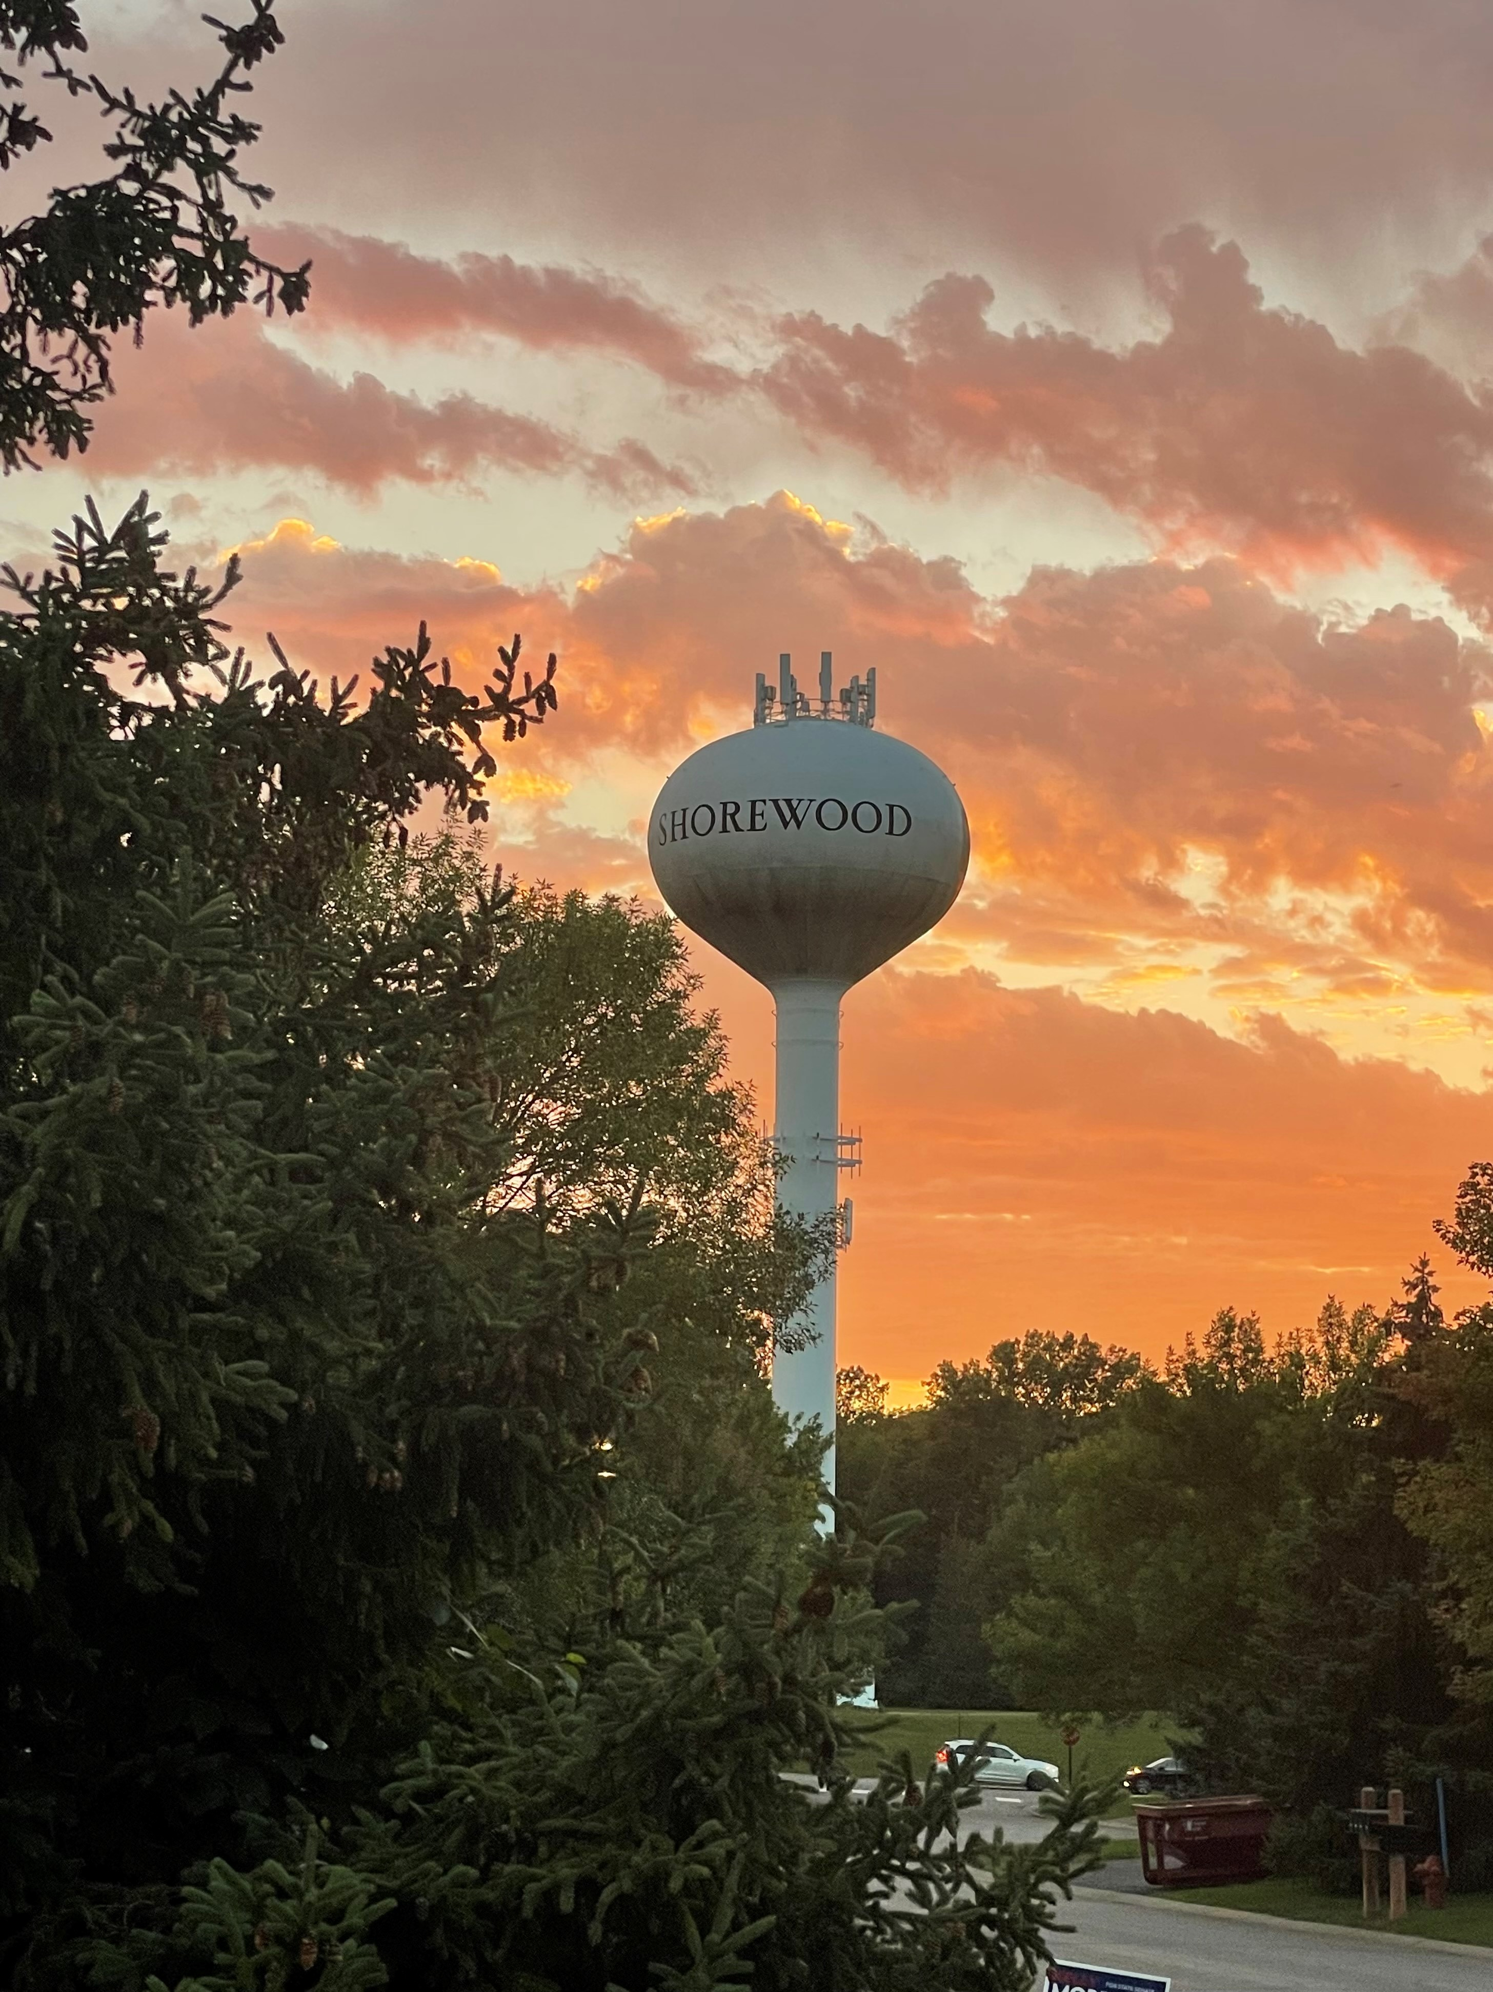
Winner in Category: Spring Wonder
“Evening Delight”
submitted by Suzann Thompson

Slide 4
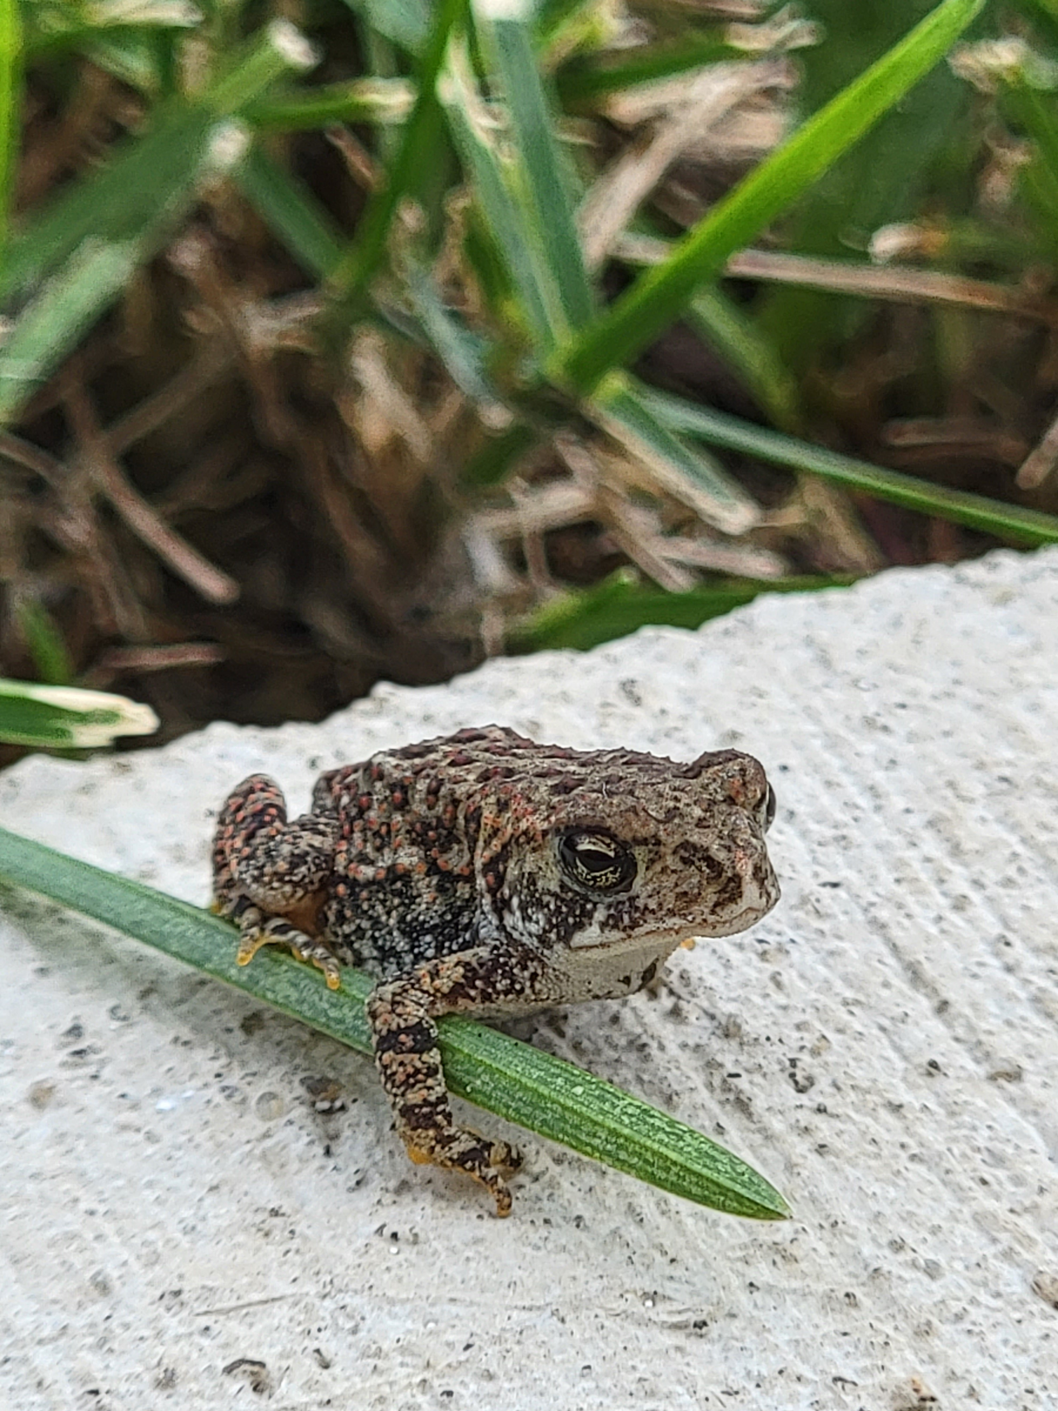
Winner in Category: Summer Delights
“Hold on to Summer”
submitted by Jocelyn Stenberg

Slide 5
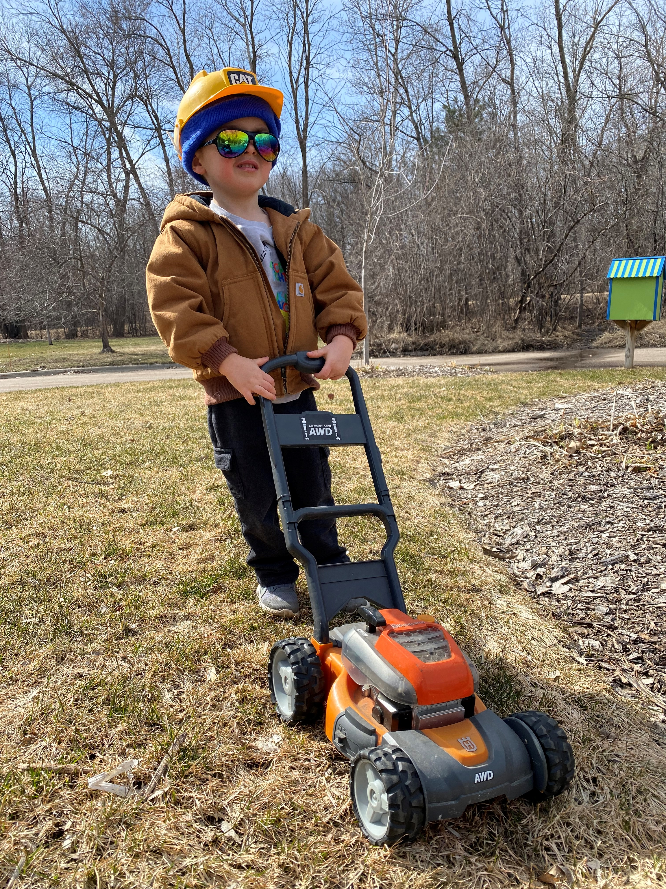
Winner in Category:
People and Pets
“Yard Working”
submitted by Daniel A. Peso

Slide 6
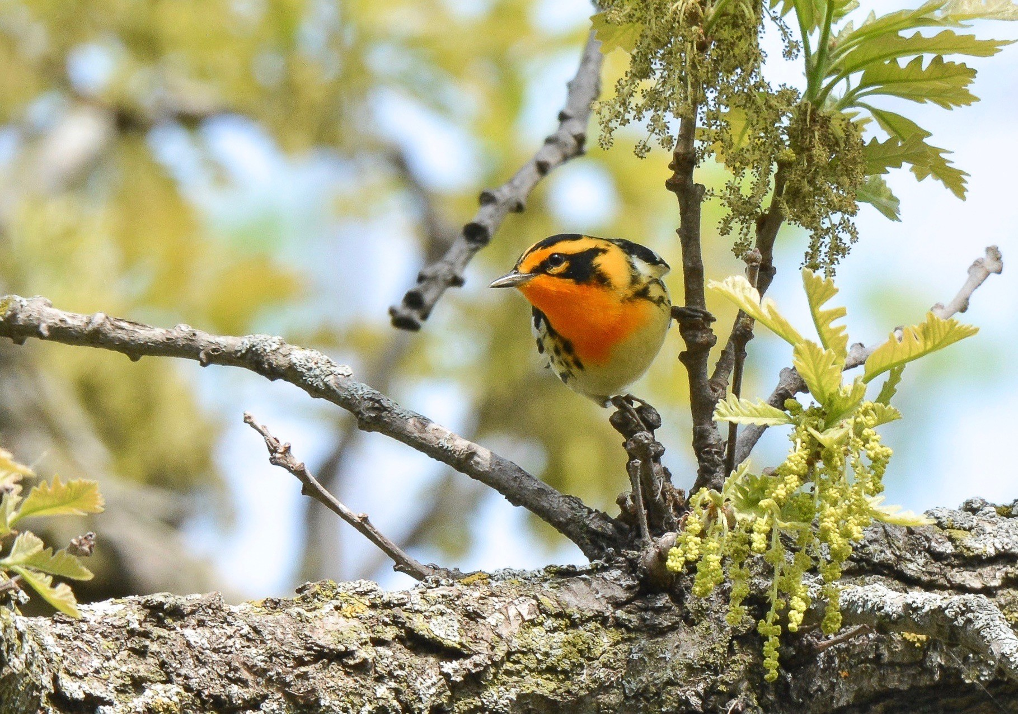
Winner in Category: Wildlife
“Blackburnian Warbler”
submitted by Judy Voigt Englund

Slide 7
THANK YOU!
To all who participated
in this fun community event!

